Slide 1
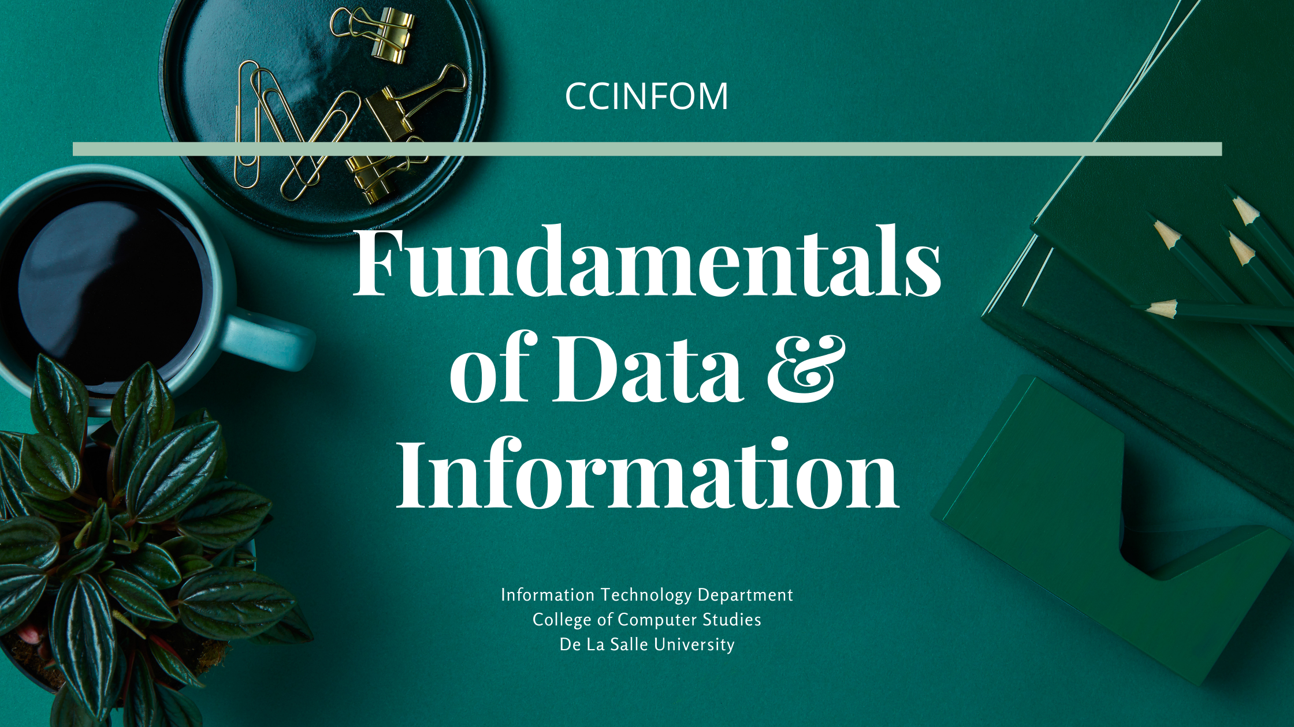

Notes:
Welcome to this session on Fundamentals of Data & Information, where the essential building blocks of databases & database applications will be presented.

Slide 2
What is data & information?
COMPUTING
da· ta
/ˈdadə,ˈdādə/
noun
facts and statistics collected together for reference or analysis
da· ta
/ˈdadə,ˈdādə/
noun
the quantities, characters, or symbols on which operations are performed by a computer, being stored and transmitted in the form of electrical signals and recorded on magnetic, optical, or mechanical recording media
Oxford Dictionary, 2019
Notes:
To better comprehend what drives the design of databases, it is important to distinguish data from information.
Data or, according to the dictionary, dada, consists of facts…
In computing, data are the
In short, it’s digital data.
Just a side note: data is already in plural form, so we don’t say “datas”. We often use the plural form since we collect data sets or groups of raw facts most of the time. The singular form of data is datum.

Slide 3
What is data & information?
COMPUTING
in· for· ma· tion
/ˌinfərˈmāSH(ə)n/
noun
facts provided or learned about something or someone
in· for· ma· tion
/ˌinfərˈmāSH(ə)n/
noun
data as processed, stored, or transmitted by a computer
Oxford Dictionary, 2019
Notes:
what is conveyed or represented by a particular arrangement or sequence of things.
We also don’t say informations, as the word information can be used in both singular and plural form.

Slide 4
What is Data and Information?
Data
No Context
Raw Facts
Information
Data with Context
11833211
11833288
Kyle Chu
11833211
Romeo Lim
Male
BSCS
Male
BSCS
11833299
11833288
Anna Tan
Female
BSCS
BSCS
Anna Tan
BSCS
11833299
Kyle Chu
Male
BSCS
Romeo Lim
Female
Male
Notes:
Data consists of raw facts that have not yet been processed to reveal their meaning. Once you process data and apply a particular context, it becomes information.
With no context, the data shown on screen can mean anything.
But if we use the context of an educational institution, like De La Salle University, we immediately understand what some of the data mean, especially because we are part of the same University. We now interpret the digits as ID numbers, and that the 1st 3 numbers represent the year the student was admitted to DLSU.
We know that BSCS stands for Bachelor of Science in Computer Science, and not Blessed Sacrament Catholic School.
We can also form records, where we relate data to each other. In this case, the related data (or fields) referring to the ID number, name, sex, and degree program comprise a student record. The data set that we have make up a total of 3 records.

Slide 5
What is Data and Information?
Data
No Context
Raw Facts
Information
Data with Context
11833211
11833288
Kyle Chu
11833211
Romeo Lim
Male
BSCS
Male
BSCS
11833299
11833288
Anna Tan
Female
BSCS
BSCS
Anna Tan
BSCS
11833299
Kyle Chu
Male
BSCS
Romeo Lim
Female
Male
Male
2
BSCS
3
Female
1
Juniors
3
Notes:
You might have further observed that there are 2 male & 1 female student, all of them are BSCS students. Moreover, all the students are also on their 3rd year.

Slide 6
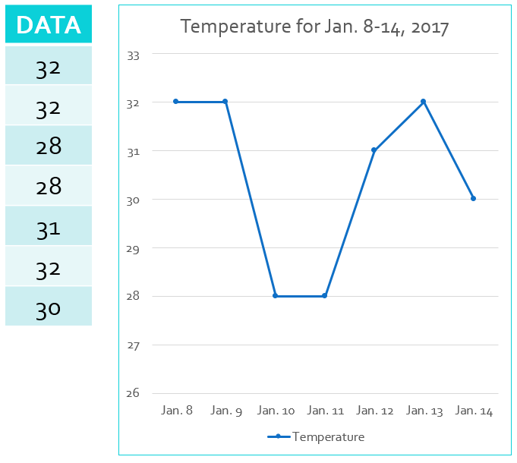
12345
Notes:
Here are other examples for the comparison data vs. information.
The number 12345 can be an identification number like a serial number or product code. It can be a price, quantity, weight, or volume of an item. It can be a date, like a birthdate or registration date. It can even be an account password.
All the items on a receipt, taken individually, are just raw data. But when you put them together in the printed or electronic document, it provides you more information such as the total amount, discounts, taxation, total number of items sold, and other details about the purchase.
When presented with a table of numbers, we can just guess what these numbers mean until it is also presented in a different way, such as how data is presented in graphs & charts. Now it is easier to understand that the numbers are temperatures recorded within a certain period, and we can even start relating & observing the temperature behavior through the visualization provided.

Slide 7
Transforming Information into Knowledge
INFORMATION
How is it tied to the results?
Are there any patterns?
What is relevant to the problem?
How does it affect the system?
What is the best way to use it?
How can we add more value to it?
KNOWLEDGE
Shaleh, 2014
Notes:
Information is the foundation of knowledge, and knowledge is essential nowadays as we transition from the ”information age” to the “knowledge age” and into becoming a “knowledge society”.
Knowledge is the body of information & facts about a specific subject. Knowledge is derived from familiarity, awareness, and understanding of information as it applies to an environment or context. You can create or extract knowledge from information by asking the following questions:
A key characteristic of knowledge is that new patterns, solutions, values, and even questions can be created from existing, old knowledge.
Simply put, we want to make sense of the data that we collect or receive and the level of processing that we place on them may vary, depending on our purpose.

Slide 8
Database Applications
Notes:
We can use a variety of IT tools & applications to help make meaning out of data and generate the information & knowledge that we need. A part of these systems are database applications.

Slide 9
Basic capability of anyone in Computing
Applications Development
Pre-requisite to CCINFOM are the fundamental programming courses of CCPROG1 and CCPROG2
One of the main outputs of CCINFOM is a database application
CCINFOM
CCAPDEV
Notes:
Application development is the process of creating a computer program or a set of programs to perform the different tasks, including decision-making activities, that an organization requires. Part of organizational requirements are data & information requirements. It is impossible to plan for, design, and/or develop any application without the knowledge of such requirements and how to manage them. This is why CCINFOM, which is Information Management, is a prerequisite to CCAPDEV.
CCAPDEV is Web Applications Development. In CCAPDEV, students are expected to develop web-based solutions, applying the concepts, principles, processes, technologies, and technical skills learned about web-based systems.
Obviously, applications development requires fundamental programming knowledge & skills, such as those you learned in CCPROG1 & CCPROG2. Hence, these courses are prerequisites to CCINFOM, as one of the main outputs of CCINFOM is a database application.

Slide 10
Database Application
A Database Application collects data and transforms it to information
Input Data
Database Application
Information
Provides humans of what it needs/wants to know
Assists humans in making decisions
Notes:
A database application is a computer program whose primary purpose is entering and retrieving information from a computerized database.
Input data enters the database application, is processed, and presented as information that intends to satisfy the data needs of the user and assist in making decisions.

Slide 11
Database Application Anatomy
The most basic form is a Single Monolithic Application
Data-based Application
Computations
Validation
Input
Output
Reading, Updating, Deletion of Data
Implementation of Rules
Report Generation
In CCPROG2, the main data storage introduced is file storage, which can be either a text or binary file.
Notes:
The anatomy of a database application helps us understand what major tasks are performed by a Database Application.
A single monolithic application describes a single-tiered software application in which the user interface and data access code are combined into a single program from a single platform. A monolithic application is self-contained and independent from other computing applications. In this case, it performs all the functions from input, processing, to report generation, and also performs reading, updating, and deletion of data.
A monolithic application is considered a ”Data-based” application, rather than a database application, as this architecture uses file storage.
In CCPROG2, the main data storage introduced is file storage, which can be either a text or binary file. We will talk more about file-based systems in a succeeding session, including its disadvantages especially when it comes to data management.

Slide 12
Database Application Anatomy
Client-Server (used in Desktop-Based Database Applications)
Database Application
Input
Database Server
Reading, Updating, Deletion of Data
Output
Computations
Validation
Implementation of Rules
Report Generation
Notes:
Database applications can be implemented using a client-server architecture.
Just to review, a client-server architecture is a hardware & software system composed of clients, servers, and middleware. It features a use of resources or a client and a provider of resources or the server. This is the type of architecture typically used in desktop-based applications.
The database application is hosted in the client side of the architecture where input, output, computation, validation, implementation of rules, and report generation are performed, while the database server is responsible for reading, updating, and deleting data.

Slide 13
Database Application Anatomy
3-Tier Architecture (used in Web-Based Database Applications)
Human Interaction
Input
Output
Processing
Computations
Database Server
Reading, Updating, Deletion of Data
Validation
Implementation of Rules
Report Generation
Notes:
We also have the three-tier architecture, which is a client-server software architecture pattern wherein the user interface (or the presentation layer), functional process logic (referring to the ”business rules"), computer data storage, and data access are developed and maintained as independent modules, most often on separate platforms. This type of architecture is typically used in web-based database applications. Mobile applications also utilize the 3-Tier software architecture.
There is a separate module for the user interface, which is used for data entry and the presentation of processed information.
Another module for processing, where most of the database application functions reside, including computations, implementation of rules, and report generation.
And another module (in this case the database server), for reading, updating, and deleting data, similar to the role of the server side in the client-server architecture.

Slide 14
Dimensions of Quality Information
Notes:
Aside from collecting data & processing it, a database application ensures that the characteristics of quality information are achieved.

Slide 15

Quality Information
When using information for business purposes and storing information in an information system, it is of vital importance that the information is good and helps you make the correct business decision.
ContentedWriter.com, 2013
Notes:
Most people agree that information is critical to how we live and work and that information, to be effective, must have quality. But what is quality information?
The meaning of information quality lies in how the information is perceived and used by people. Although absolute attributes are important, it is the perception of those attributes, now and in the future, that defines information quality.

Slide 16
Quality Information
Accessible
Accurate
Complete
Economical
Flexible
Relevant
Reliable
Secure
Simple
Timely
Verifiable
Notes:
Quality information should be
We will be discussing these characteristics one by one.

Slide 17
Quality Information
ACCESSIBLE
Can the information be easily obtained?
Information should be easily accessible by authorized users so they can obtain it in the right format and at the right time to meet their needs.
Notes:
Accessible information is information that is stored in a way that it can be easily retrieved at any time. For example, looking at sales figures on a cash register at any time of the day and having the feature of printing out current sales from the cash register means that the information is accessible. If it took one hour to process the sales figures and print them then this information would not be easily accessible. Accessibility is an important characteristic of good information as users need to have information available to them as and when they need it.

Slide 18
Quality Information
ACCURATE
Is the information error-free?
Information is error-free. In some cases, inaccurate information is generated because inaccurate data is fed into the transformation process.
Notes:
Accuracy is to be ensuring that the information is correct and without any mistake. Information accuracy is important because the life of people may depend on it like the medical information at the hospitals. In some cases, inaccurate information is generated because inaccurate data is fed into the transformation process.
If the speedometer in your car was out by 30kph then this information may result in you breaking the law. Similarly if a sales department sent inaccurate sales figures to the finance department this might result in incorrect tax calculations for the company that would put them in danger.

Slide 19
Quality Information
COMPLETE
Are all necessary details presented?
Information contains all the important facts.
Notes:
For the next dimension, we have completeness. Here we check if all necessary details are presented.
This quality exists if the information contains all the important facts.
Incomplete information can lead users astray. An example of this is the old story of blind travelers encountering an elephant in the road with each, after examining a small section, coming to a different conclusion regarding the object's identity. However, complete information for one person may be incomplete for another. For example, the marketing vice-president and the director of research and development for a pharmaceutical company may both be interested in the clinical trials tests for a new drug or vaccine, but each may require different levels of detail given their differences in roles & responsibilities in the organization.
Just as information whose precision exceeds a customer's processing capability may be too accurate, information may also be too complete. The classic example is a lawyer dumping boxes of material on an adversary's desk, knowing that it will be impossible to unearth the few relevant facts buried within.

Slide 20

Quality Information
ECONOMICAL
Is there a balance between value of information and cost of production?
Information should be relatively economical to generate & use.
Notes:
We ask if there is a balance…
Cost effective information is information that is worth investing the time and money to get to help make decisions. As an example, if you own a business and paid another company to do a survey for you and it cost PHP50,000.00 and you were then able to use the information supplied to increase your profits by PHP 75,000.00 in the next month, then this could be seen as cost effective information. However, if the survey cost PHP 200,000.00 to complete and the information only saw a PHP 5,000.00 increase in sales in the next month, then this information would not be seen as cost effective. Economical information is information that costs a lot less to put together than the resultant profit from analyzing and using the information to increase profits.

Slide 21
Quality Information
FLEXIBLE
Is the information workable with others?
Information can be used for a variety of purposes.
Notes:
One may ask:
Information is said to be flexible if it can be used for a variety of purposes.
One example of flexible information that we can easily find is that of the weather & the weather forecast. The high & low temperature, humidity, amount of precipitation, sunrise & sunset can be used in various contexts.
On an everyday basis, many use weather forecasts to determine what to wear on a given day. Since outdoor activities are severely curtailed by heavy rain, storm signals, & expected wind speeds, forecasts can be used to plan activities around these events, and to plan ahead and survive them. Forecasts based on temperature and precipitation are important to agriculture, and therefore to traders within commodity markets. Temperature forecasts are used by utility companies to estimate demand over coming days.
Flexibility contributes to the economical trait of information, by making the information produced useful by several people or by various units in an organization.

Slide 22
Quality Information
RELEVANT
Does the information address the user’s needs?
Relevant information is important to the decision maker.
Notes:
Information that is relevant means that it is fit for what you need & important for the decision to be made.
If you are trying to identify what courses you can take next as part of your degree program, you will be looking at your own curriculum flowchart and the courses offered by your home department or college in the enrollment system.
If a business was looking to cut costs they might look at their utility consumption and electricity bill and try to see where they could save money. If a bakery was looking at the price of metal then this would not really be relevant information to their business. Relevant information for a bakery would be looking at the price of ingredients to use in their products or ways to prolong the shelf-life of their baked goods.

Slide 23
Quality Information
RELIABLE
Can the information be trusted?
Depends on the reliability of the data-collection method or source of the information.
Notes:
Accuracy was mentioned earlier as a dimension of quality information. Aside from this characteristic, information should also be reliable.
An example of reliable information source would be information from your sales department that is supplied to the financial department on the sales figures for last month. As this comes from an internal information source it is reliable and can be trusted. If you wanted information about the population of Korea then using Wikipedia might not be seen as being 100% reliable and you may not be 100% confident in using this source. However, if you looked at the census information from the Korean Government you could say what the population was, at the time that the census was taken.

Slide 24
Quality Information
SECURE
Is the information protected?
Information should be secure from access by unauthorized users.
Notes:
The secure dimension of quality information looks at whether the information used & obtained is protected.
Historically, information security has been a stepchild of the information technology revolution. Two aspects of information security are protecting information from people (which is logical security) and protecting information from natural disasters (as those involved in disaster recovery planning). Logical security relies on logical barriers such as passwords, data encryption, and transaction authentication, along with human vigilance. Disaster recovery planning involves protecting information and ensuring that appropriate backup and alternate processing procedures are in place. The topic of information security has become increasingly visible in recent years. Breaches of information security are a potential Achilles' heel for the entire information technology revolution because information that is not secure cannot be trusted and will not be used to its fullest potential.

Slide 25
Quality Information
SIMPLE
Does the information have a functional representation?
Information should be simple, not overly complex. Sophisticated detailed information is not always needed.
Notes:
Moving on, we have simplicity as the next quality trait.
If someone requests information from you having the correct level of detail is very important.
For example, if a manager wants a summary of the sales figures for the last 6 months, then the information that has the right level of detail might show the overall sales figures for each month and the grand total added together.
Giving the manager a complete list of all sales for every product you sold in the six-month period in a 1000-page report would be seen as having not the right detail and would not really be a summary. When presenting information it is important to understand what exactly the person requesting the information needs.
Keeping information simple means ensuring that it is understandable by the end user. If a non financial person wanted information about the sales for the last 3 years and you presented them with a complex set of figures taken from a database with no clear totals then they would not understand it. However, if you knew exactly what they wanted you might present them with an easy to read graph with clear instructions on the totals sales for each of the last 3 years.

Slide 26
Quality Information
TIMELY
Is the information up-to-date?
Timely information is delivered when it is needed.
Notes:
Timely information is information that is from the correct time period.
It is information that is delivered when needed.
If a company wants to analyse current profit and loss then they will need to access current sales figures and not the sales figures from 10 years ago. On the other hand, a patient’s medical history within the last 10 years may still be relevant depending on his or her current medical condition. Implicit in this definition is a dynamic process where new information arises to replace the old. Information has a cycle time that depends on how quickly new information can be processed and communicated to its customer.
For information quality to exist, timeliness and accessibility should complement each other. Timely information that is inaccessible or accessible information that is obsolete cannot satisfy an information customer's needs.

Slide 27
Quality Information
VERIFIABLE
Can the information be verified?
Information should be verified. This means that you can check to make sure it is correct.
Notes:
Lastly, quality information is verifiable. This means that you can check the information to make sure it is correct. Is there enough evidence to check if the information is correct? Can other information sources be used for verifying the information at hand?
Information should also be verifiable as being true and satisfying appropriate standards related to other dimensions such as accuracy, timeliness, completeness, and security. The most common form of verification is auditing information, either as an ongoing practice or as part of a special project. Auditing can uncover mistakes and is an accepted measure of information quality. Verifiability results to information validity.

Slide 28
Quality Information
Being unaware of information quality needs may lead either to wasting millions on unnecessary technology or to passing up a breakthrough technology and with it, an opportunity to obtain competitive advantage.
Miller, 1996
Notes:
There are other desirable attributes of information identified by other authors such as value/value-adding, believability, coherence, format, reputation, and interpretability. Regardless of which metrics you use to assess information quality, it is important to guarantee that these are facilitated by the database application.
In today's environment, information quality as defined by almost every dimension discussed requires information technology. However, technology can be a double-edged sword: use properly and live by it; use improperly and die by it. Organizations that have not defined their information quality needs and do not understand how a new product affects their fundamental interests can be led astray. Being unaware of information quality needs, may lead either to wasting millions on unnecessary technology or to passing up a breakthrough technology and with it, an opportunity to obtain a competitive advantage by closing a quality gap or redefining a process.

Slide 29
Data Processing Basics
Notes:
In order to to make certain that the aforementioned information qualities are present in the data & information that you gather & process, it is also important to perform data management, especially when you or the organization is handling a large volume of data. Just look at the contents of your enrollment assessment form, as well as the variety of data types contained therein, and multiply that by the number of students in the university. Data management is an administrative process that includes acquiring, validating, storing, protecting, and processing required data to ensure the accessibility, reliability, and timeliness of the data for its users.
Data management has also grown in importance as businesses are subjected to an increasing number of regulatory compliance requirements, including data privacy and protection laws. Effective data management is an essential piece of deploying different IT or computer systems that run business applications and provide analytical information to help drive decision-making.

Slide 30
Data Lifecycle
Collected or Created
Stored and Organized
Processed
Presented or Used
Shared or Distributed
Notes:
Data management activities follow the data lifecycle, which represents all of the stages of data throughout its life from its creation to its distribution and reuse.
Data starts off by being collected or created, usually through forms or data entry. Data collection can also be done through signal reception, such as those used by smart devices to communicate as part of the Internet of Things or IoT.
Next, data is stored & organized according to certain business rules or categories defined by the organization. Bear in mind that not all data that is collected or created are stored. Only those which are relevant will be stored.
After storage & organization, data is transformed into information based on the needs of the user or the organization.
Data that is processed is not always just for the sole consumption of the person who processed it. It can also be shared or distributed to other users, user groups, or systems, through a myriad of channels. The output information is then used by it’s recipients or presented to another set of users.
Based on what was presented or how the data or information was utilized, a new set of data requirements can be identified to be collected or created to start lifecycle once again.

Slide 31
Data Processing
Type 1
Relating data together to form records
Type 2
Mathematical processing
Updating and deletion of data
Type 3
Relating records to each other
Type 4
Generation of reports
Generation of lists
Includes grouping, filtering, and sorting
Notes:
This keeps on being mentioned, but what are activities that make up data processing?
With processing, we are able to make sense of the data provided and turn it into useful information for individual users or the entire organization.
Data processing can be classified into four types.
What we did in an earlier part of the session, relating the student to their respective ID numbers, sex, and degree program, is categorized as Type 1 data processing.
Type 2 involves mathematical processing, including summations, averages, and statistical functions like mean, median, and mode. This type also includes updating & deletion of data.
For Type 3, records are related to other records. Suppose the student records earlier also included the student’s current CGPA. Comparing the CGPA of student A to student B, will fall under type 3 data processing.
Lastly, we have Type 4 data processing, which covers the generation of lists & reports, including grouping, filtering, and sorting. Your curriculum audit in MyLaSalle involves type 4 data processing, where a list of all courses that you have taken & not taken so far, is generated by the system. Class lists generated by your faculty instructors using MyLaSalle based on enrollment data is also classified under this type.
This CCINFOM course will include SQL writing to perform all of the types of data processing mentioned.

Slide 32




What is the importance of learning fundamental data concepts?
Notes:
It is already quite cliché to say that data is all around us. Not only is it ubiquitous, but also essential for organizations to survive, compete, and be successful in their respective industries. Imagine trying to operate a business without knowing the stakeholders: who your customers are, who is working for you, who owes you money, and to whom you owe money. As an organization you need to know about your products and services, and which ones need to be improved. All businesses have to keep this type of data and much more. Just as important, they must have that data available to decision makers when necessary. It can be argued that the ultimate purpose of all business information systems, IT systems, and other software applications, is to help businesses use information as an organizational resource. At the heart of all of these systems are the collection, storage, aggregation, transformation, distribution, and the overall management of data & it’s quality.

Slide 33
References
ContentedWriter.com (2013). Characteristics of good information. Retrieved from https://contentedwriter.com/characteristics-of-good-information/
Coronel, C. & Morris, S. (2017). Database systems: design, implementation, and management, 13th ed. Boston, MS: Cengage Learning.
Golett, M. (2016). What is data management? NGDATA. Retrieved from https://www.ngdata.com/what-is-data-management/#:~:text=Data%20management%20is%20an%20administrative,the%20data%20for%20its%20users.
Miller, H. (1996). The multiple dimensions of information quality. Information Systems Management. Spring96, Vol. 13 (2), pp. 79-82.
Oxford Dictionary
Rouse, M. (2018). What is data management & why is it important? TechTarget. Retrieved from https://searchdatamanagement.techtarget.com/definition/data-management

Slide 34
Questions?
PLEASE POST YOUR QUESTIONS IN THE DISCUSSION BOARD CREATED FOR THIS TOPIC.
Notes:
If there is an AnimoSpace discussion board created in your class for this topic, kindly post your questions there in order for the rest of the class to see the replies. Otherwise, you may reach out to your instructor through the communication channels provided.

Slide 35

Notes:
That is the end of this session. Please check the AnimoSpace course for your section and keep yourself updated regarding other relevant materials or tasks on this topic. Thank you and keep safe always.

